Slide 1
MOVIE DATABASE USING BINARY SEARCH TREE
TEAM MEMBERS :
13BCE0081 - SAURABH THAKUR
13BCE0585 – VIVEK PAWAR
13BCE0743 - VAIBHAV VISHAL

Slide 2
TEAM CONTRIBUTIONS
TEAM MEMBER | CONTRIBUTION
SAURABH THAKUR 13BCE0081 | -PROJECT CODE DEVELOPMENT -INTERFACE DEVELOPMENT
VIVEK PAWAR 13BCE0585 | -PRESENTATION DEVELOPMENT -DOCUMENTATION
VAIBHAV VISHAL 13BCE0743 | -DOCUMENTATION

Slide 3
DATA STRUCTURE USED
USED DATA STRUCTURE : BINARY SEARCH TREE
FOR ANY NODE N IN THE BST, THE KEY OF N IS GREATER THAN THE KEY OF ALL NODES IN ITS LEFT SUBTREE. SIMILARLY, THE KEY OF N IS LESS OR EQUAL TO THE KEY OF ALL NODES IN ITS RIGHT SUBTREE.
THE SEARCHING, INSERTION AND DELETION OPERATIONS IN A BINARY SEARCH TREE ARE PERFORMED ON THE BASIS OF COMPARISON OF KEY VALUES.
The key is the name of the movie and a unique ids have been used to avoid collisions if they occur.

Slide 4
SOFTWARE DETAILS
SOFTWARE USED
1)Python IDE Version 2.7.8
TOOLS
1) Tkinter Graphic Interface
2) IMDB Application user interface version 5.0

Slide 5
PROPOSED IDEA
THE PROPOSED IDEA IS TO CREATE A MOVIE DATABASE USING THE PROPERTY OF THE BINARY SEARCH TREE (BST).
HERE, THE BST IS USED TO HOLD THE MOVIES AND THEIR CORRESPONDING DETAILS LIKE MOVIE ID, YEAR OF RELEASE AND RATINGS etc.
EVERY MOVIE HAS A UNIQUE ID ASSOCIATED WITH IT WHICH ACTS AS A COLLISION HANDLER WHEN INSERTING THE MOVIES IN THE TREE.
THIS IDEA MAKES SEARCHIG OF MOVIE HIGHLY FAST.

Slide 6
ADVANTAGES
THE ADVANTAGES OF USING BST IS THAT IT MAKES THE SEARCHING PROCESS FASTER.
THERE IS EASY INSERTION AND DELETION OF MOVIES SINCE ALL OPERATIONS ARE BASED ON THE COMPARISON OF THE KEY VALUES.
THIS HELPS TO CREATE A LARGE ROBUST AND FAST DATBASE FOR EASY ACCESS OF MOVIES
THE ONLINE MODE GIVES ACCESS TO ALL INFORMATION AVAILABLE ABOUT THE MOVIE ON WEB INCLUDING THE POSTER URL TO CAST AND DIRECTORS LIST

Slide 7
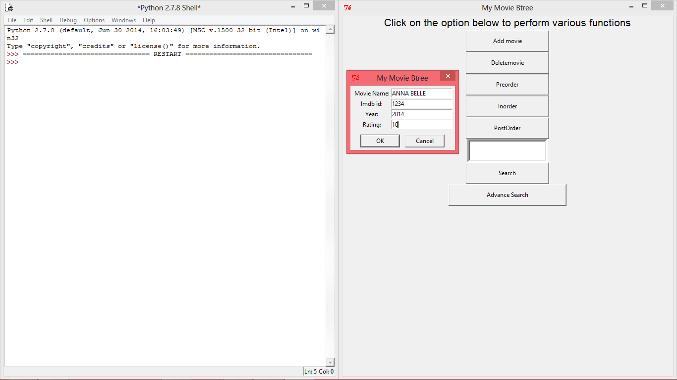
The user interface

Slide 8
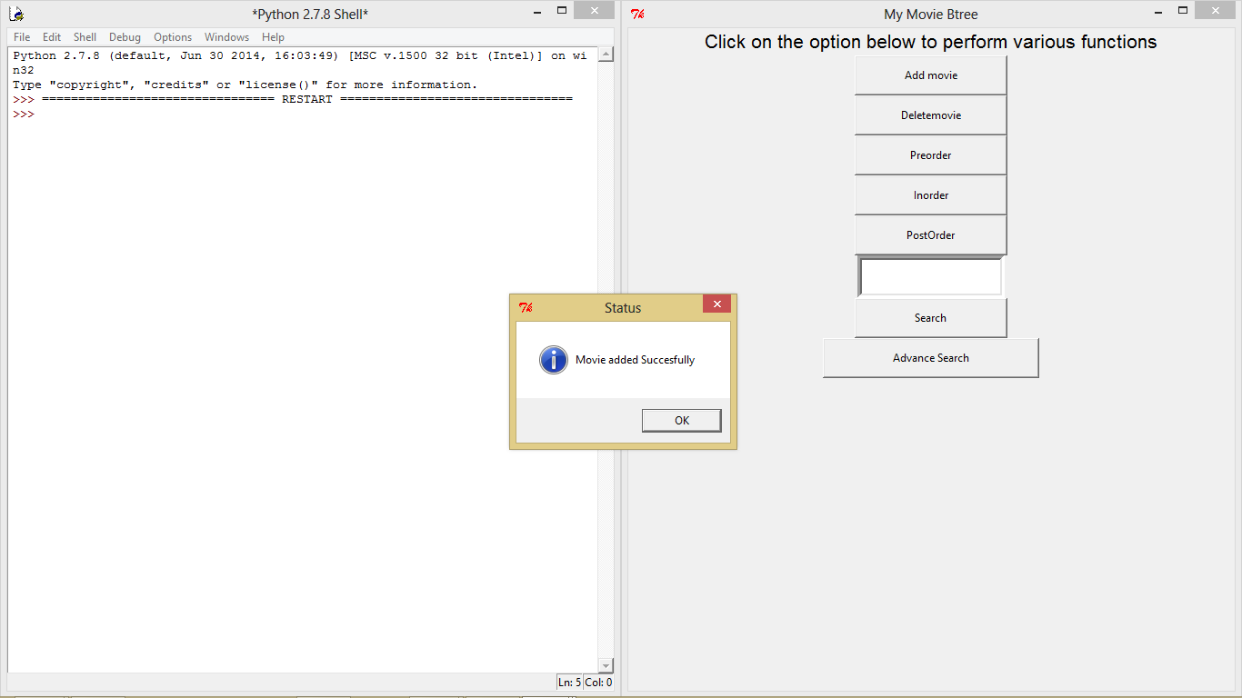
The user interface

Slide 9
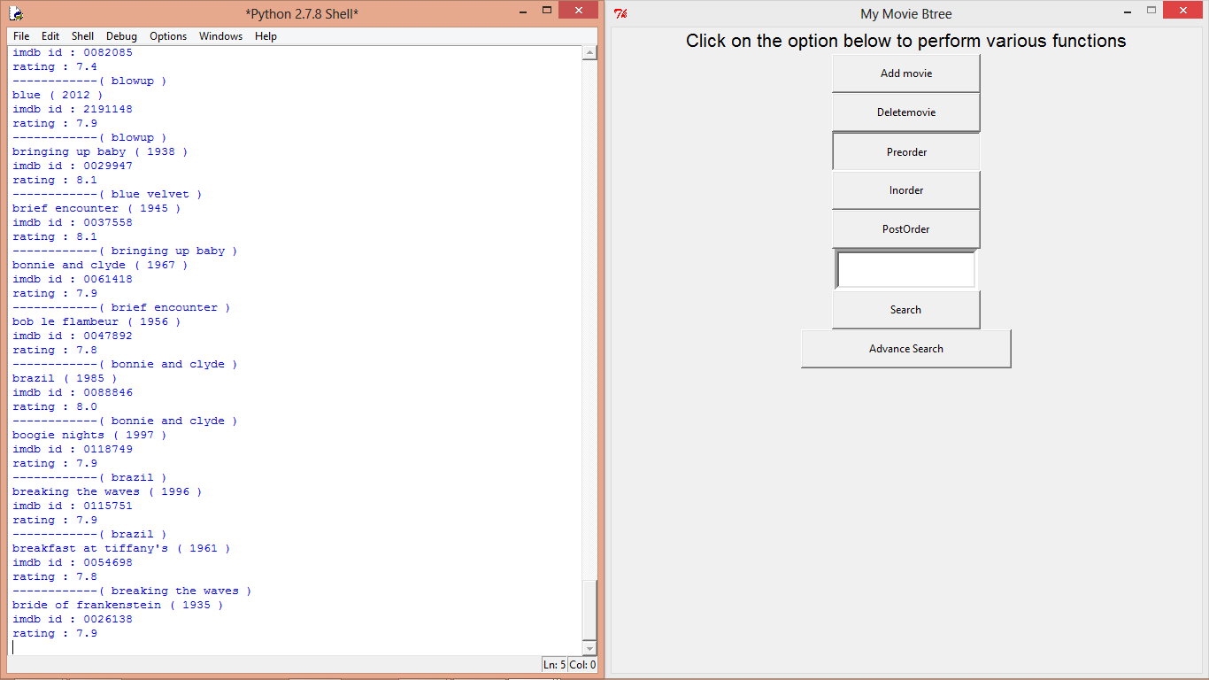
The user interface

Slide 10
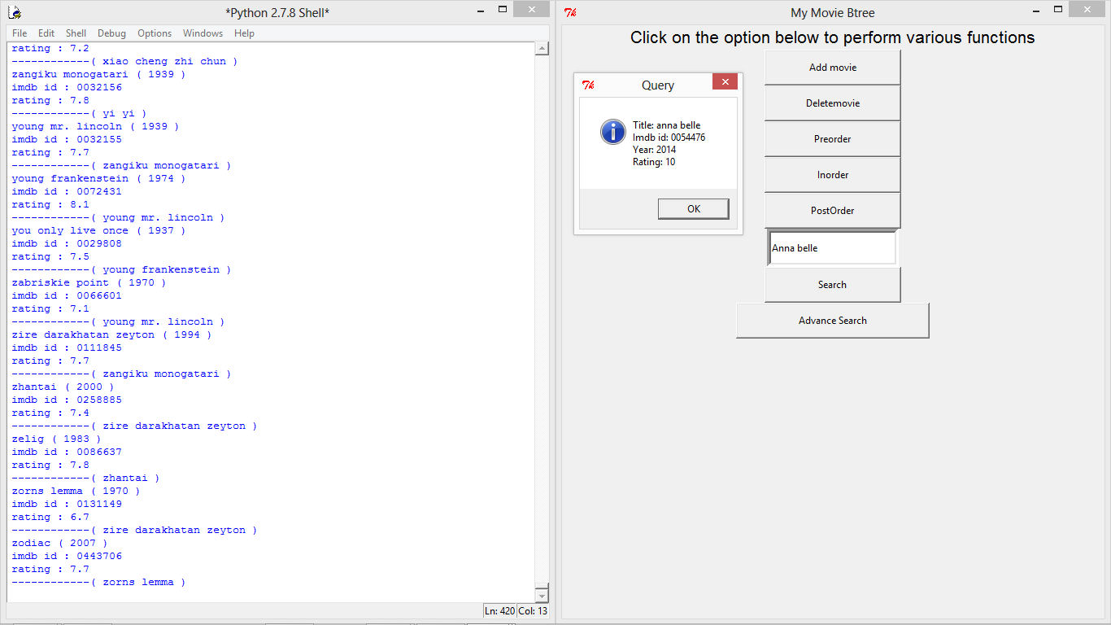
The user interface

Slide 11
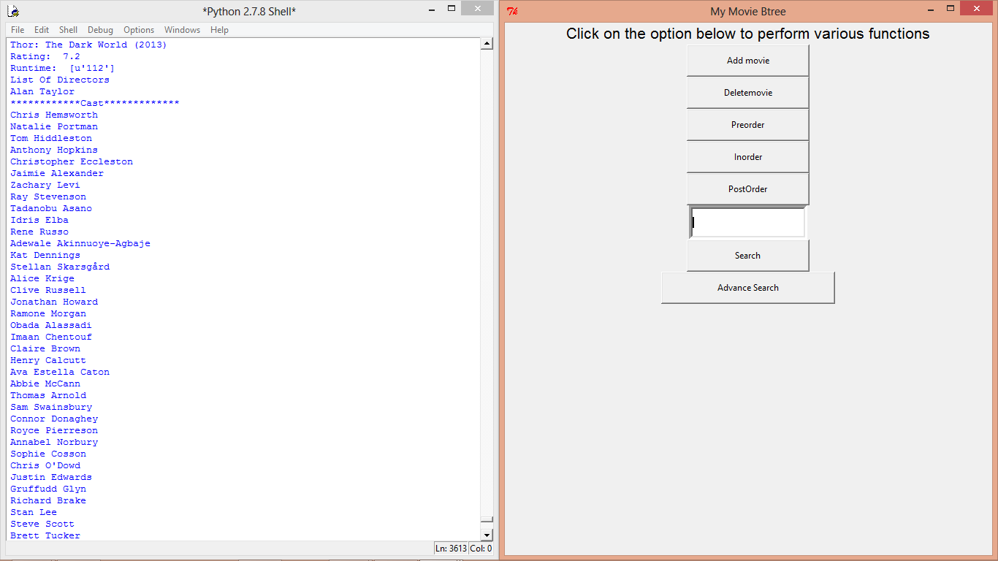
The user interface

